Slide 1
Chapter 8: Designing and developing applications for z/OS

Slide 2
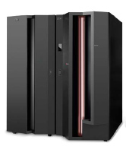
Chapter objectives
Be able to:
Describe the roles of the application designer and application programmer.
List the phases of the application development life cycle.
Briefly describe the process for testing a new application on z/OS.
Describe the advantages and disadvantages of using batch versus online for an application.
List three reasons for using z/OS as the host for a new application.

Slide 3
Key terms in this chapter
application
architecture
database
design
develop
enablement
executable
infrastructure
platform
requirement
transaction
unit test

Slide 4
What is an application?
Screenshot 1
An application
  A piece of software that will satisfy certain specific requirements or resolve certain problems
  The solution can reside on any platform or combination of platforms
Notes:
What is an application?
An application is a collection of programs that satisfies certain specific requirements
(resolves certain problems). The solution could reside on any platform or combination of
platforms, from a hardware or operating system point of view.

Slide 5
Who designs applications for the mainframe?
Application designer:
Determines the best programming solution for an important business requirement.
Understands:
  Business objectives of the company
  Other roles in the mainframe IT organization
  Company’s hardware and software.
Has a global view of the entire project.
Notes:
The application designer is responsible for determining the best programming solution
for an important business requirement. The success of any design will depend in part on
the designer’s knowledge of the business itself, awareness of other roles in the
mainframe organization such as programming and database design, and understanding of
the business’s hardware and software. In short, the designer must have a global view of
the entire project.
As part of the design process, the designer gathers requirements from business analysts
and end users and determines which IT resources will be available to support the
application. Depending on the complexity of the project, the designer might involve other
specialists to assist in the design process.

Slide 6
Who writes applications for the mainframe?
Application programmer:
Builds, tests, and delivers the applications that run on the mainframe for end users
Works from the application designer’s specifications
Uses a variety of tools
Application programming involves many iterations of:
Code changes and compiles
Application builds
Unit testing.
Notes:
The application programmer is responsible for developing and maintaining application
programs. That is, the programmer builds, tests, and delivers the application programs
that run on the mainframe for the end users. Based on the application designer’s
specifications, the programmer constructs an application program using a variety of
tools. The build process includes many iterations of code changes and compiles,
application builds, and unit testing.
Besides creating new application code, the programmer is responsible for maintaining
and enhancing the company’s existing mainframe applications. In fact, this is frequently
the primary job for many application programmers on the mainframe today. While many
mainframe installations still create new programs with COBOL or PL/I, languages such
as Java have become popular for building new applications on the mainframe, just as on
distributed platforms.

Slide 7
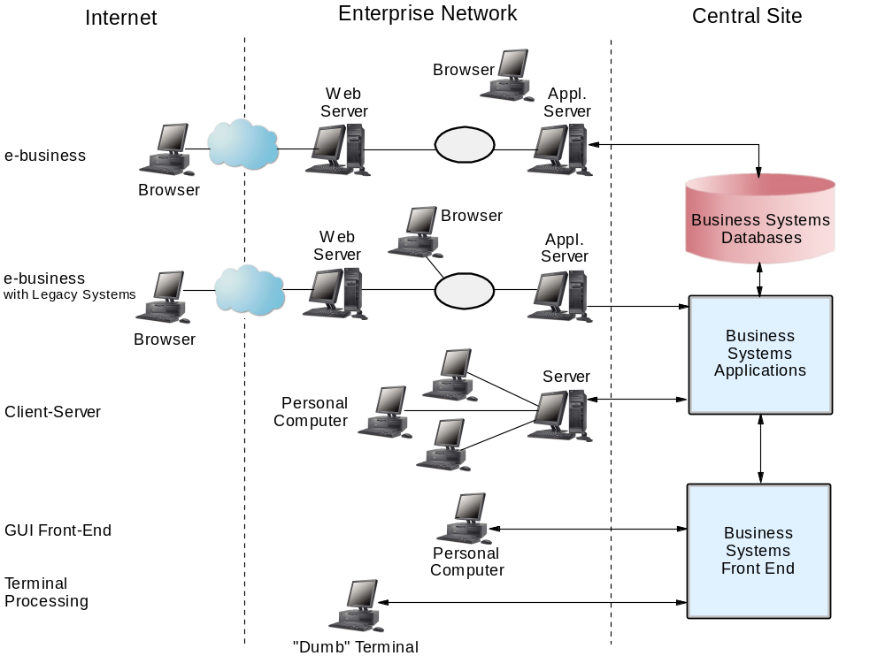
Where applications reside
Notes:
Our infrastructure is growing in complexity. An application can have pieces in the Internet, the Enterprise Network and on the mainframe – central site.
Literally, the picture becomes very complex, but this is the real world. We have applications talking to each other that reside on different platforms.
With all of the possibilities, we need to have a good understanding of what we have and of where we are going. It is for this reason that the Requirements Gathering phase is so critical to the success of the project.
As the slide shows, our application can be located in any of the three
environments: Internet, enterprise network, or central site. The operating system must
provide access to any of these environments.

Slide 8
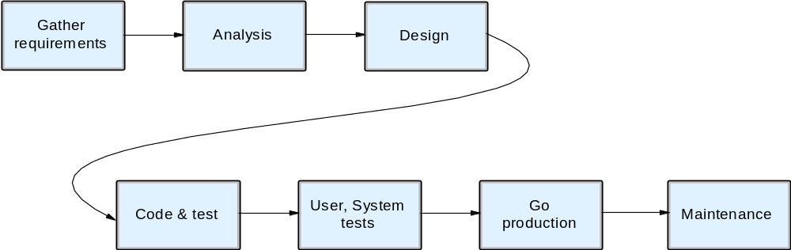
Application development lifecycle
Notes:
The process flow during the various phases of the application development lifecycle.
The phases of the lifecycle are:
Gather requirements
User, hardware, software etc.
Analysis
Design
High-level design
Detailed design
Hand over to programmers
Code and test application
Perform system tests
User tests – functionality, usability
Integration test
Performance test
Go production - hand off to production control
Ensure all documentation is in place
Change status of source to production
Maintain - day-to-day changes and enhancements to application

Slide 9
Gathering requirements for the design
Requirements:
  Assess what needs to be accomplished
    Based on projects constraints
    Always keep in mind the end result
    Conduct interviews with users and stakeholders
    Verify our assumptions
Notes:
When designing applications, there are many ways to classify the requirements:
Functional requirements, non-functional requirements, emerging requirements, system
requirements, process requirements, constraints on the development and in the
operation—to name a few.
An important advantage to the zSeries approach is that applications can be maintained
using tools that reside on the mainframe. Some of these mainframe tools make it possible
to have different platforms sharing resources and data in a coordinated and secure way
according to workload or priority.

Slide 10
Types of requirements
Accessibility
Client
Interoperability
Recoverability
Serviceability
Availability
Connectivity
Performance
Resource can be monitored, controlled, managed, and administered
Usability
Frequency of data backup
Distributed
Portability
Secure centralized controllable capacity
Web services
Changeability
Inter-communicable
Preventing failure and fault analysis

Slide 11
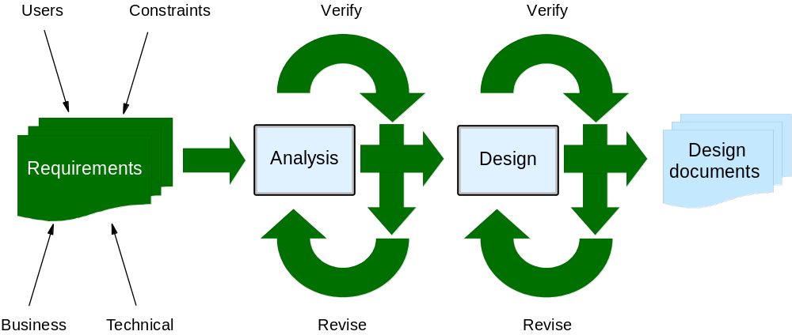
Design phase
Notes:
This figure depicts the design phase up to the point of starting development. Once all of the requirements have been gathered, analyzed, verified and a design has been produced, we are ready to pass on the programming requirements to the developers.
This is probably one of the most intensive parts of the process. Solutions are looked at individually as well as in the context of the whole project. The decisions made in the Analysis phase culminate in the final design.
Analysis
Examine the requirements in the context of all of the other variables within the scope of the project
Verify and revise if necessary
Repeat until complete

Slide 12
Design decisions – based on requirements
Batch versus online
Database, tape, flat file, etc.
COBOL, PL/I, JAVA, Assembler
z/OS, Unix, Linux, Windows
Capacity of server
Server type
Develop or purchase package or both
Notes:
Many options need to be weighed in coming to the final solution:
Batch versus online
Data organization
Programming language
Operating system
Size of the server
Architecture
Developing versus purchasing a solution
The resulting design includes:
High-level design
Detailed design
Information for developers
Information about data
Information about hardware, software

Slide 13
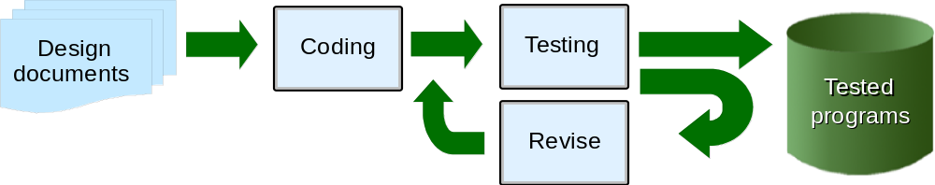
Development phase
Notes:
The programmers take the design documents (programming requirements) and proceed with the iterative process of coding, testing, revising and testing again.

Slide 14
Developing an application for the mainframe
Programmer uses as input the specifications of the designer
Usually follows this process:
  Code a module.
  Test a module for functionality.
  Make corrections to the module.
  Repeat from step 2 until successful.

Slide 15
Programming tools for the mainframe
  Editor
    TSO or ISPF-based or GUI
  Repository for source code
    PDS, SCLM or some other repository
  Job monitoring and viewing software
    SDSF or equivalent product
  Debugging tools

Slide 16
Debugging a program on the mainframe
  Log on to TSO
  Enter ISPF – check out source code
  Edit source and make modifications
  Submit compile JCL to verify syntax
  Switch to SDSF to view job status
  View job output in SDSF – check for errors
  Correct errors
  Repeat from “Submit” until errors are corrected
  Save source code in repository
Notes:
For more information on how each of these activities is accomplished, refer to the chapters on TSO, ISPF, etc.

Slide 17
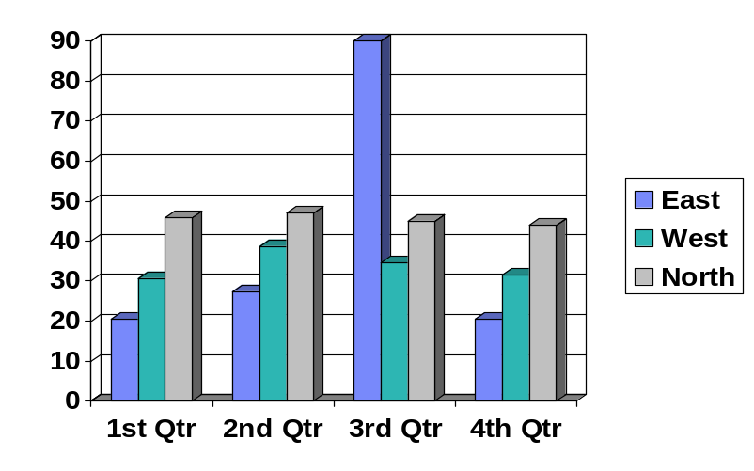
Interactive Development Environment (IDE)
IDEs accelerate development process
  Edit source on work station
  Run compiles off-platform
  Perform remote debugging
  Useful for “hybrid” applications
    Host-based COBOL with CICS, IMS, and Web browser-like interface
    Provides unified development environment to build OLTP in HLL and HTML front-end interface
Notes:
Today, mainframe application programmers often use Interactive
Development Environment (IDE) tools to accelerate the edit/compile/test process. IDEs
such as the WebSphere Studio Enterprise Developer allow application programmers to
edit, test, and debug source code on a workstation instead of directly on the mainframe
system. The use of the IDE is particularly useful for building “hybrid” applications that
employ host-based programs or transactional systems, but also contain a Web
browser-like user interface.

Slide 18
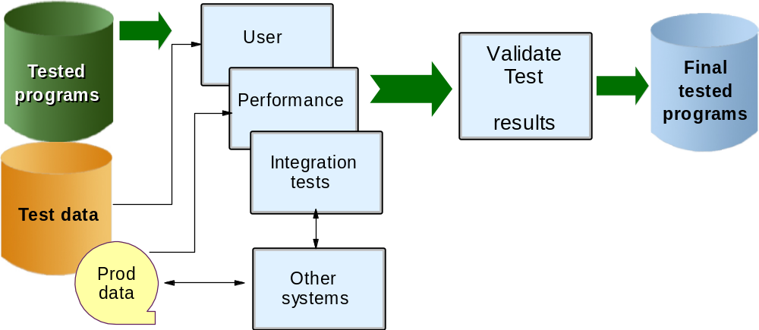
Test phase
Notes:
Once the programs have been tested by the developers, the programs will be part of a series of formal tests: user tests and system tests. These tests will be used to verify usability and functionality from a user point of view as well as to verify the functions of the application within a larger framework.
The difference between the testing done at this stage and the testing done during the
development phase is that we are now testing the application as a whole, as well as in
conjunction with other applications. We also carry out tests that can only be done once
the application coding has been completed because we need to know how the whole
application performs, and not just a portion of it.
The tests performed during this phase are:
User testing - The user tests the application for functionality and usability.
Integration testing - The new application is tested together with other applications to
see if they interface as expected.
Performance or stress testing - The application is tested using real production data or
at least real production data volume to see how well the application performs when
there is high demand.

Slide 19
Test phases (continued)
Many levels of testing
  User testing for functionality, acceptance
  Performance (stress) testing
  Integration testing (with other systems)
Validate the testing results
Final step before going production
Notes:
The results of the user and integration tests need to be verified to ensure that they are
satisfactory. In addition, the performance of the application must match the requirements.
Any issues coming out of these tests need to be addressed before going into production.
The number of issues encountered during the testing phase are a good indication of how
well we did our design work.

Slide 20
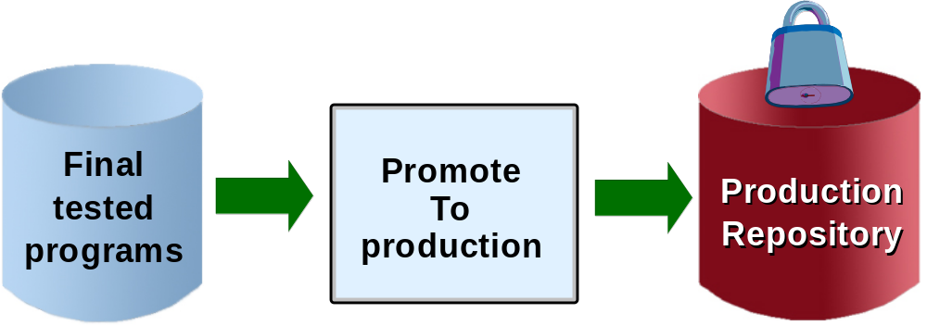
Production phase
Notes:
Production marks the end of the development lifecycle. From this point onward, everything is tightly controlled. You don’t want to introduce a change into a working environment that causes it to no longer work.
The act of “going into production” is not simply turning on a switch that says now the
application is production-ready. It is much more complicated than that. And from one
project to the next, the way in which a program goes into production can change.
In some cases, where we have an existing system that we are replacing, we might decide
to run in parallel for a period of time prior to switching over to the new application. In
this case, we run both the old and the new systems against the same data and then
compare the results. If after a certain period of time we are satisfied with the results, we
switch to the new application. If we discover problems, we can correct them and continue
the parallel run until there aren’t any new problems.
In other cases, we are dealing with a new system, and we might just have a cut-over day
when we start using it. Even in the case of a new system, we are usually replacing some
form of system, even if it’s a manual system, so we could still do a parallel test if we
wanted to.

Slide 21
Go production
Document:
  Operational procedures
  Training manuals (users, administrators, etc.)
Promote application to production status
  Implement change control process
Hand over to operations
Notes:
Whichever method is used to go into production, there are still all of the loose ends that
need to be taken care of before we hand the system over to Operations. One of the tasks is
to provide documentation for the system, as well as procedures for running and using it.
We need to train anyone who interacts with the system.
When all of the documentation and training has been done, then we can hand over
responsibility for the running of the application to Operations and responsibility for
maintaining the application to the Maintenance group. In some cases, the Development
group also maintains applications.

Slide 22
Maintenance phase
Ongoing day-to-day changes/enhancements
Responsibility for maintenance may change to another group or stay with developers
Notes:
At this point, the application development life cycle reaches a steady state and we enter
the maintenance phase of the application. From this point onward, we only apply
enhancements and day-to-day changes to the application. Because the application now
falls under a change control process, all changes require testing according to the process
for change control, before they are accepted into production. In this way, a stable,
running application is ensured for end users.

Slide 23
Maintaining and enhancing existing systems
Screenshot 2
Maintenance and enhancement is a primary role of HLL programmers on the mainframe
Large corporations continue to use COBOL and other traditional languages for new development:
  Existing applications are in HLLs such as COBOL and PL/I
  New applications are in JAVA, COBOL and PL/I COBOL, PL/I continue to be enhanced to exploit new technologies and new data formats
Notes:
COBOL is used more extensively than PL/I in mainframe environments.

Slide 24
Summary
Designing and developing an application for the mainframe is similar to other platforms, but some of the questions and conclusions are different.
Life cycle of designing and developing an application to run on z/OS includes phases of:
  Requirements gathering and analysis
  Design
  Development
  Test and debugging
  Production
  Maintenance

